Slide 1

BAYESIAN COLLABORATIVE DENOISING FOR MONTE-CARLO RENDERING
Malik BOUGHIDA
Tamy BOUBEKEUR

Slide 2
Outline
Introduction
Theory: Bayesian denoising of Monte Carlo noise
Application: Bayesian Collaborative Denoising for Monte Carlo Rendering
Conclusion

Slide 3
Outline
Introduction
Theory: Bayesian denoising of Monte Carlo noise
Application: Bayesian Collaborative Denoising for Monte Carlo Rendering
Conclusion

Slide 4
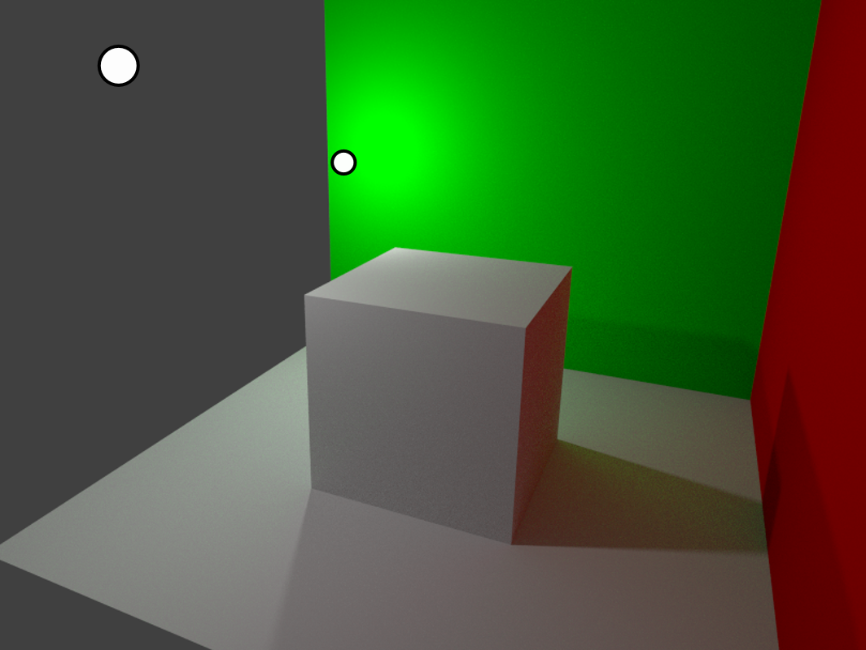
Application in rendering: Monte Carlo path tracing
1 sample = RGB color value for 1 random path
1 pixel = average of n samples

Slide 5
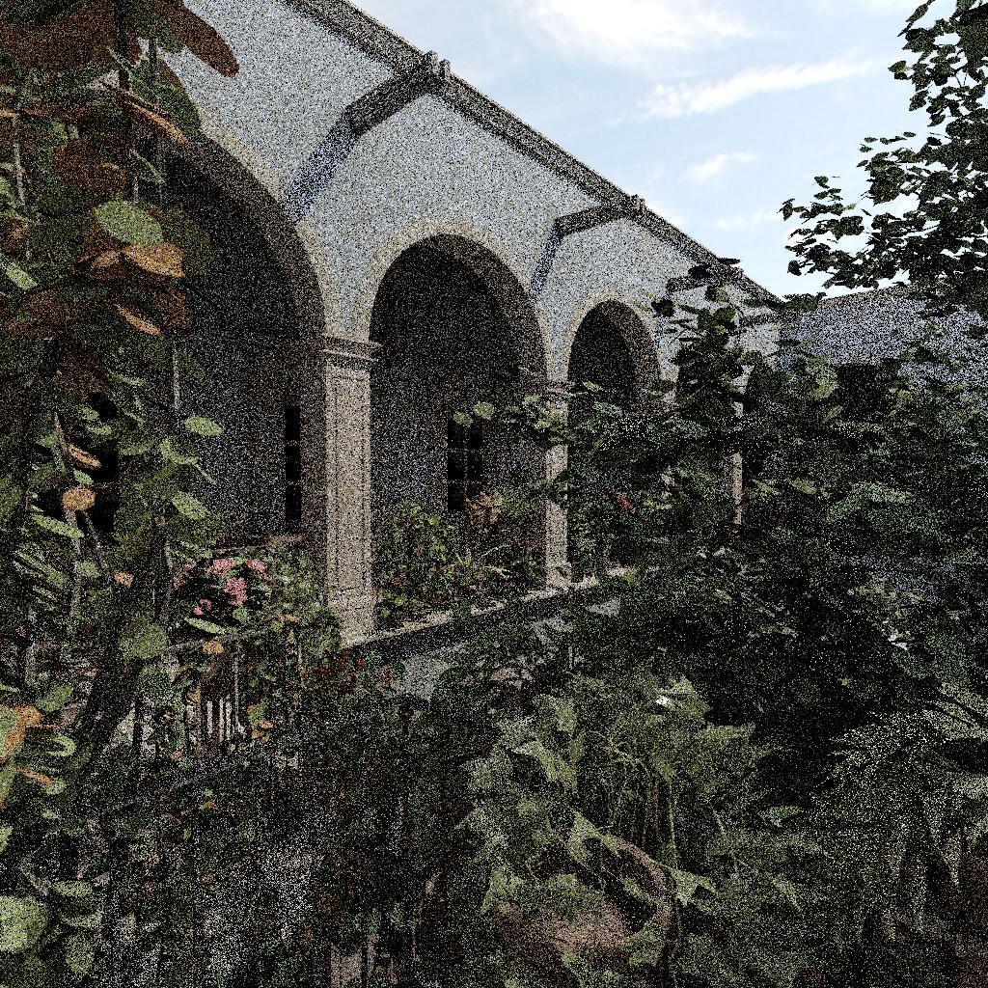
Monte Carlo noise
4 samples per pixel
(4 spp)

Slide 6
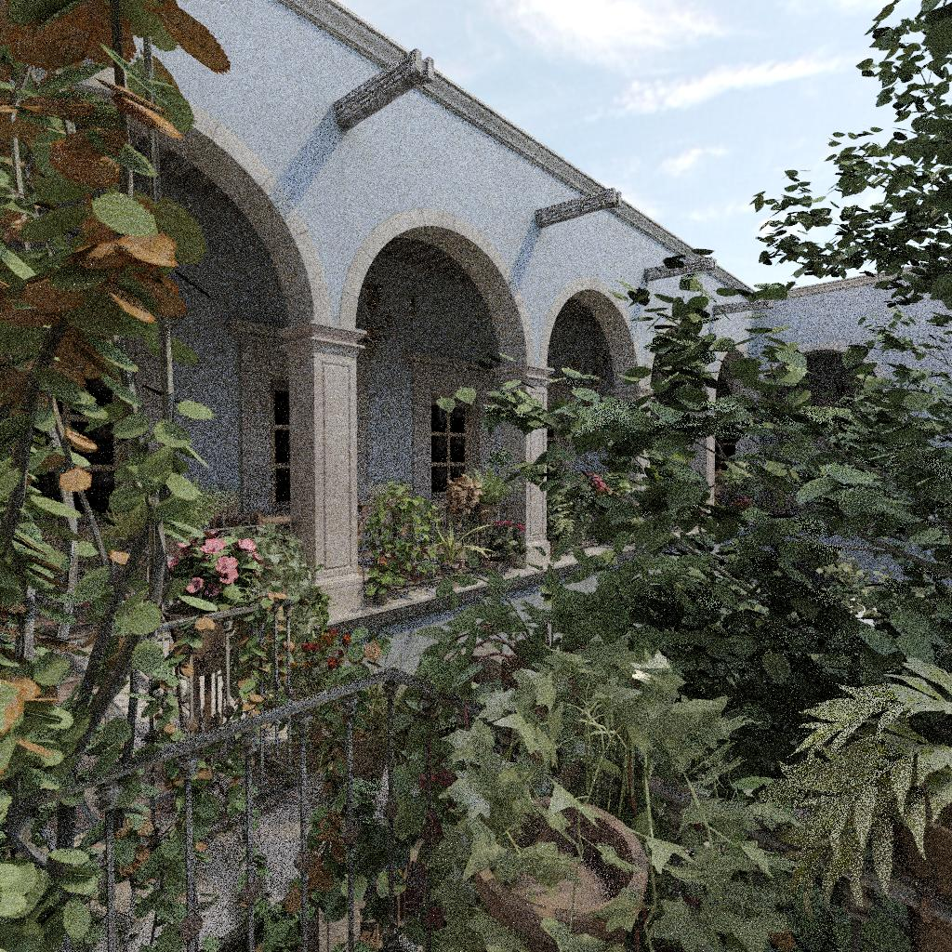
Monte Carlo noise
24 samples per pixel
(24 spp)

Slide 7
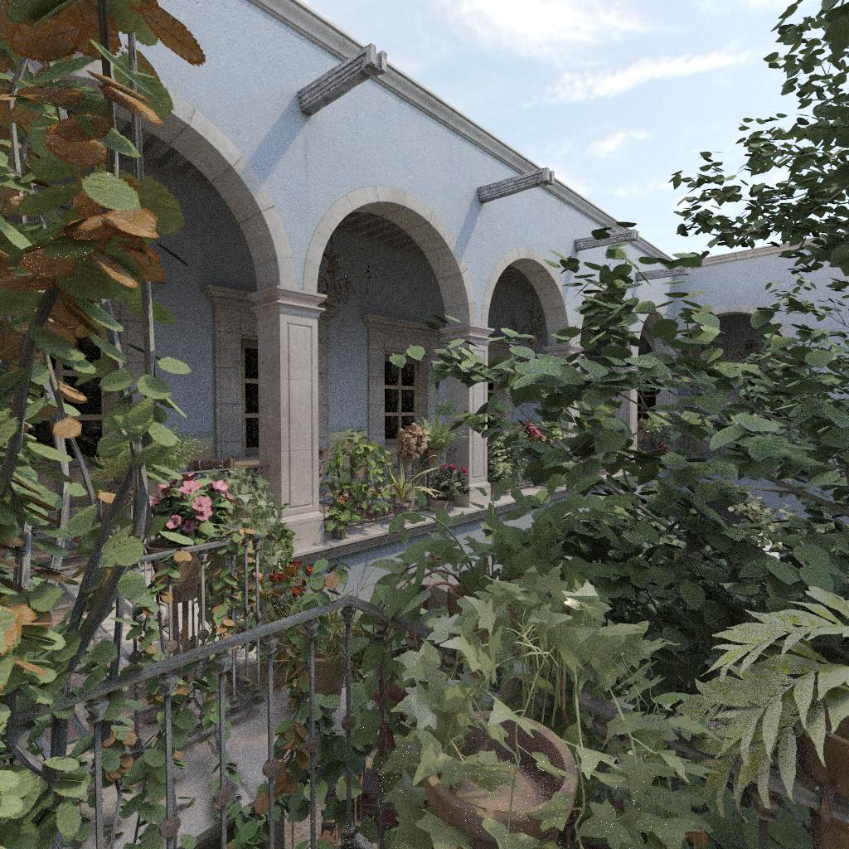
Monte Carlo noise
256 samples per pixel
(256 spp)

Slide 8

Monte Carlo noise
65536 samples per pixel
(65536 spp)

Slide 9
Goal
Time
Slow
convergence
Denoising

Slide 10
Previous work: denoising in image processing
Denoising methods (examples)
Noise model
Filtering
  Median
  Bilateral
  Joint bilateral
Optimization
  Total variation
Patch-based methods
  Non-Local Means [Buades 2005]
  BM3D [Dabov 2006]
  Non-Local Bayes [Lebrun 2013]
Additive
Gaussian
Isotropic
Uniform
Wrong in Monte Carlo rendering
(see next)

Slide 11
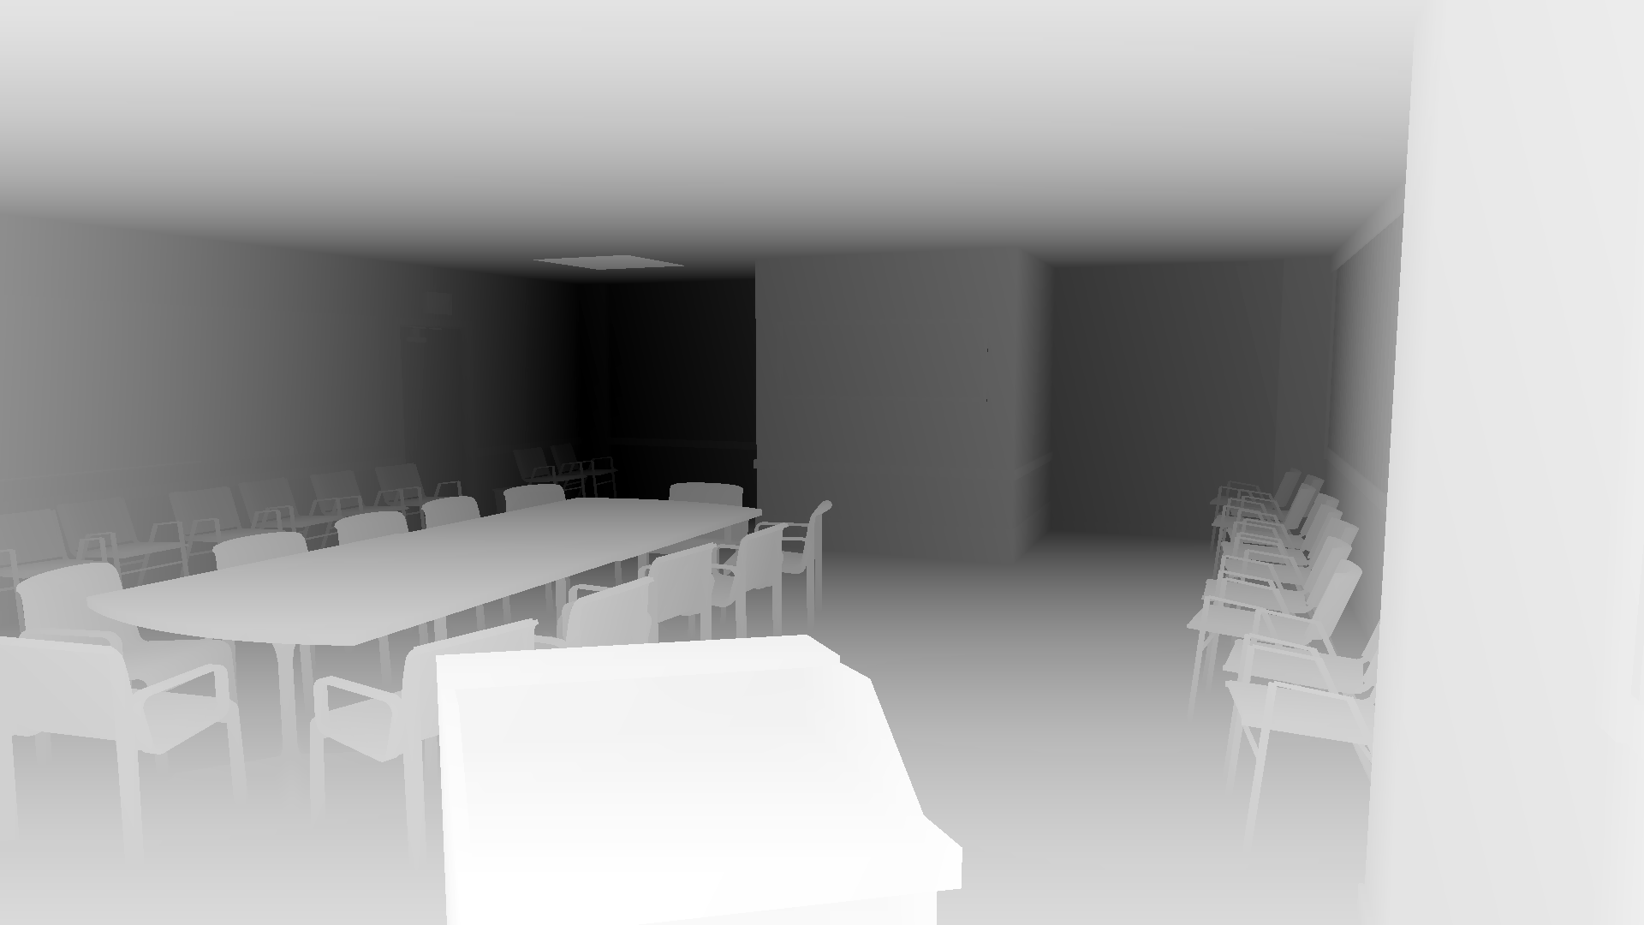
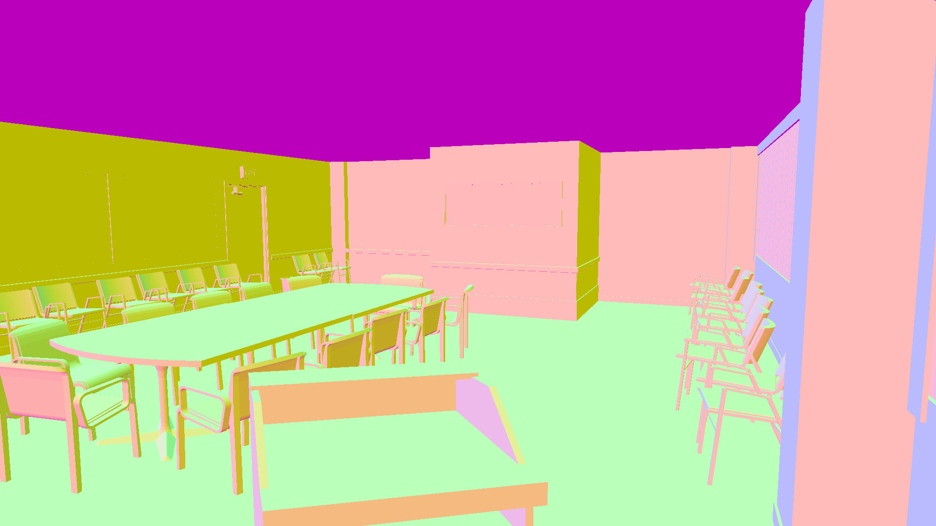
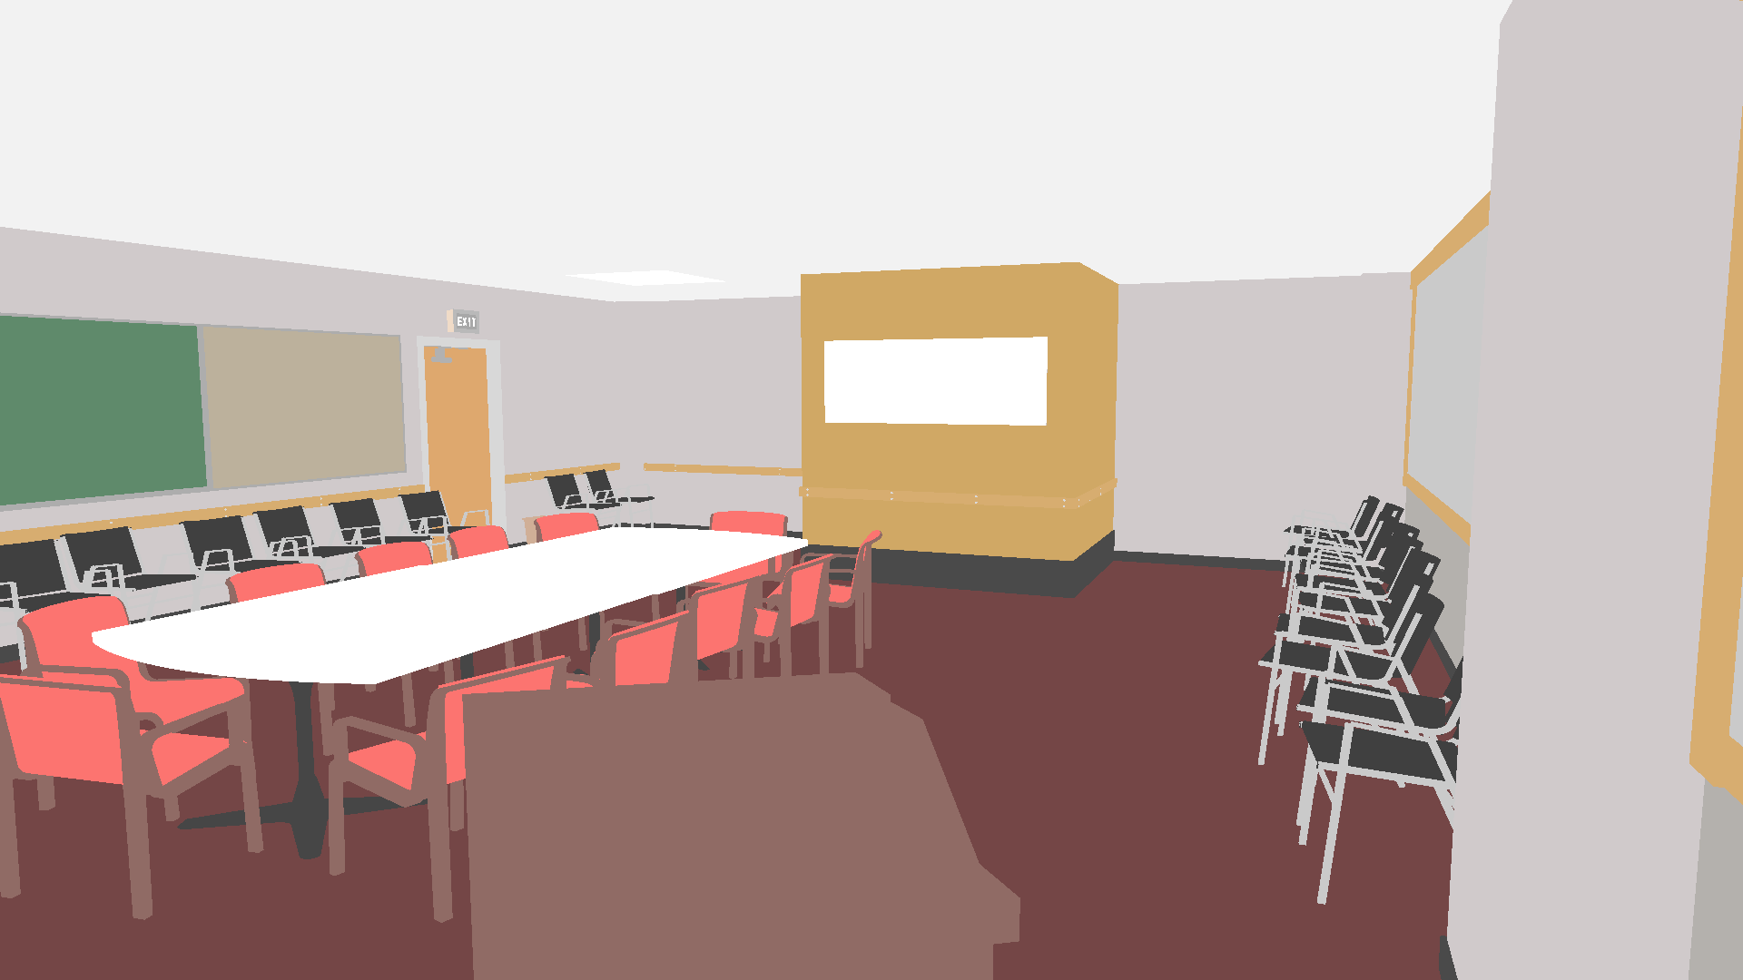
Previous work: denoising of Monte Carlo rendering
Monte Carlo increasingly used in production
Very active topic last few years
Paradigms feature-based vs sample-based
  Features: G-buffer (normal, albedo), caustics, …
  Samples: see Ray Histogram Fusion [Delbracio 2014]
Others:
  Adaptive sampling and reconstruction [Rousselle 2011]
  Local estimation of filtering parameters [Sen 2012]
  Frequential analysis in path space [Belcour 2013]
  Machine learning (neural networks in [Kalantari 2015])
  Local polynomial reconstruction [Moon 2016]
  Local choice between feature-based or sample-based filtering [Bitterli 2016]

Slide 12
Outline
Introduction
Theory: Bayesian denoising of Monte Carlo noise
Application: Bayesian Collaborative Denoising for Monte Carlo Rendering
Conclusion

Slide 13
Bayesian denoising of Monte Carlo noise
Bayesian denoising
Monte Carlo noise
Prior distribution
Bayesian denoising formula for Monte-Carlo noise

Slide 14
Bayesian denoising of Monte Carlo noise
Bayesian denoising
Monte Carlo noise
Prior distribution
Bayesian denoising formula for Monte-Carlo noise

Slide 15

Bayesian denoising
$$≈$$
Noisy
value
Groundtruth
Noise
Estimator
(denoised value)
?
Noise model
(opposite)
?
?
Prior
distribution
of groundtruth
Maximum A Posteriori Estimator
?
Bayes rule

Slide 16
Bayesian denoising of Monte Carlo noise
Bayesian denoising
Monte Carlo noise
Prior distribution
Bayesian denoising formula for Monte-Carlo noise

Slide 17
Monte Carlo noise
Distribution of 1 sample
Distribution of 1 pixel
No known model
Extremely complex
Extreme values
Depends on:
  all the scene parameters
  rendering algorithm
Pixel = mean of n i.i.d. samples

Slide 18
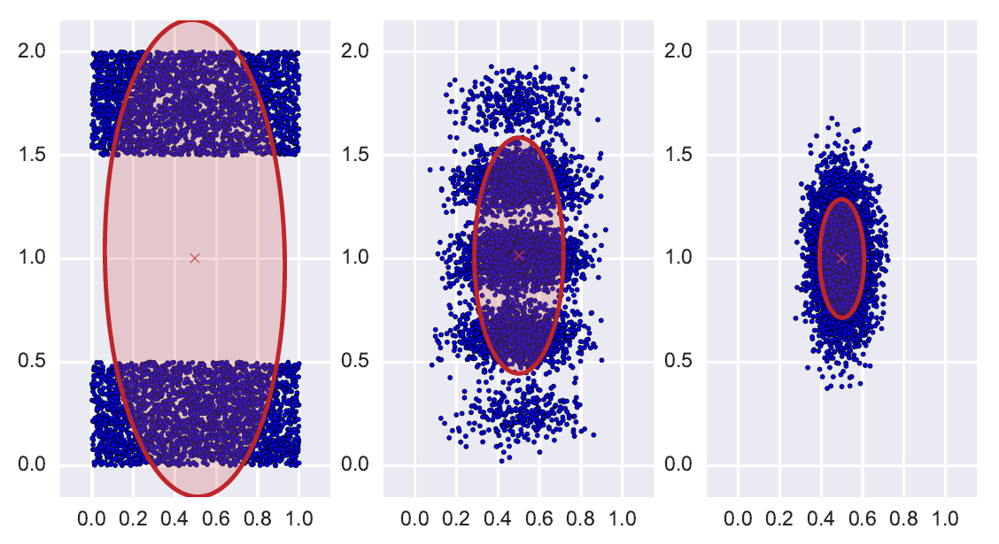
Monte Carlo noise: Central Limit Theorem
n = 1
C₁ ≈ C
n = 4
n = 16
C₄ ≈ C/4
C₁₆ ≈ C/16
1 point
=
mean of
n i.i.d. realizations
Sample
mean
Sample
covariance
Uniform distribution with covariance C

Slide 19
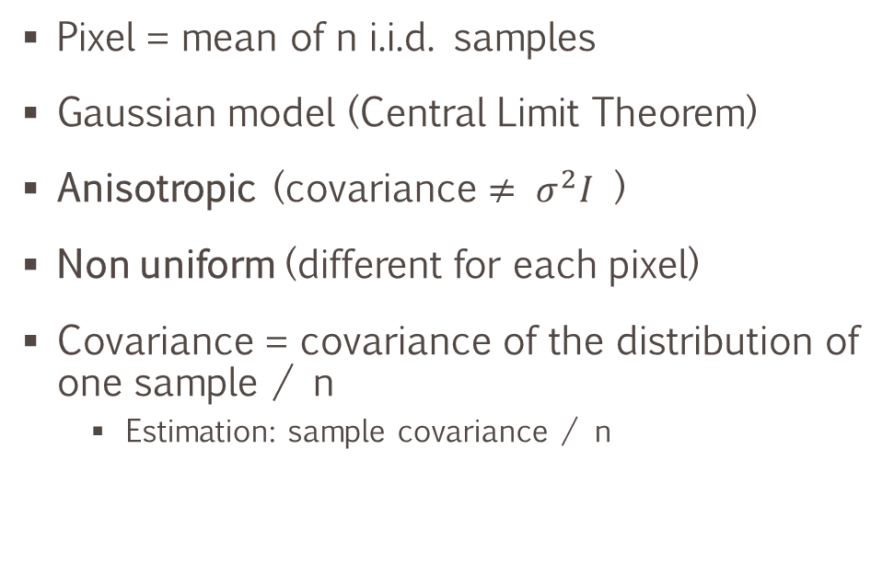
Monte Carlo noise
Distribution of 1 sample
Distribution of 1 pixel
No known model
Extremely complex
Extreme values
Depends on:
  all the scene parameters
  rendering algorithm
Pixel = mean of n i.i.d. samples
Gaussian model (Central Limit Theorem)
Anisotropic (covariance $≠ σ^{2}I$ )
Non uniform (different for each pixel)
Covariance = covariance of the distribution of one sample / n
  Estimation: sample covariance / n

Slide 20
Bayesian denoising
$$≈$$
Noisy
value
Groundtruth
Noise
Estimator
(denoised value)
Noise model
(opposite)
Prior
distribution
of groundtruth
Maximum A Posteriori Estimator
Bayes rule

Slide 21
Bayesian denoising of Monte Carlo noise
Bayesian denoising
Monte Carlo noise
Prior distribution
Bayesian denoising formula for Monte-Carlo noise

Slide 22

A priori distribution: gaussian model from neighbors
Noisy neighbors
(choice? see later…)
Noisy prior
distribution (sample cov.)
$$−$$
Average noise
Noiseless prior
distribution
Denoised value

Slide 23
Bayesian denoising of Monte Carlo noise
Bayesian denoising
Monte Carlo noise
Prior distribution
Bayesian denoising formula for Monte-Carlo noise

Slide 24
Bayesian denoising formula
noisy
value
local
noise
noisy
value
neighbors
mean
neighbors
covariance
average
noise
local
noise
Clamped eigen values (important)
Noise: anisotropic, non uniform, with estimated covariance C_{i} for pixel i
(unlike Non-Local Bayes [Lebrun 2013])

Slide 25
Outline
Introduction
Theory: Bayesian denoising of Monte Carlo noise
Application: Bayesian Collaborative Denoising for Monte Carlo Rendering
Conclusion

Slide 26
Bayesian Collaborative Denoising for Monte Carlo Rendering
Previous work: Ray Histogram Fusion
Algorithm
Extensions
Results
Discussion

Slide 27
Bayesian Collaborative Denoising for Monte Carlo Rendering
Previous work: Ray Histogram Fusion
Algorithm
Extensions
Results
Discussion

Slide 28
Ray Histogram Fusion [Delbracio 2014]
Principles
similar
natures
Good filtering = mixing pixels of similar natures
Nature of a pixel ?
  Noisy color value → not enough
  Features → sometimes not enough
  Sample distribution
different
natures

Slide 29
Sample distribution [image from RHF paper]

Slide 30
Ray Histogram Fusion [Delbracio 2014]
Principles
similar
natures
Good filtering = mixing pixels of similar natures
Nature of a pixel ?
  Noisy color value → not enough
  Features → sometimes not enough
  Sample distribution
In practice: sample histograms
Simple final denoising (average)
different
natures

Slide 31
Bayesian Collaborative Denoising for Monte Carlo Rendering
Previous work: Ray Histogram Fusion
Algorithm
Extensions
Results
Discussion

Slide 32
Algorithm: overview
INPUTS
Color buffer
OUTPUT
Color buffer
Covariance buffer
Denoised color
Set of patches
of similar nature
Histogram buffer
Covariance buffer
Denoised patches
Accumulate denoised
patches in output buffer
Select positions with
similar histograms
Extract color and
covariances there
Associated noise
covariance estimates
HISTOGRAM-BASED
PATCH SELECTION
COLLABORATIVE DENOISING
AGGREGATION

Slide 33
Algorithm: first step of collaborative denoising
Noisy neighbors
(choice? HISTOGRAMS)
Noisy prior
distribution (sample cov.)
$$−$$
Average noise
Noiseless prior
distribution
Denoised values

Slide 34

Algorithm: second step of collaborative denoising
Noisy neighbors
(choice? HISTOGRAMS)
Denoised values
(first step)
Denoised prior
distribution
$$=$$
Noiseless prior
distribution
Denoised values
(second step)

Slide 35
Bayesian Collaborative Denoising for Monte Carlo Rendering
Previous work: Ray Histogram Fusion
Algorithm
Extensions
Results
Discussion

Slide 36
Extensions
Multi-scale filtering → getting rid of low-frequency noise

Slide 37
Extensions: multi-scale
Colors
Sub-sampling
Covariances
Histograms
Filtering
copy
high freq
high freq
high freq
Final
result
low freq
low freq
low freq

Slide 38
Extensions
Multi-scale filtering → getting rid of low-frequency noise
Adaptive sampling
  Alternating adaptive rendering / denoising
  Number of samples to render computed from covariances and denoising results

Slide 39
Extensions: adaptive sampling
Adaptive
rendering
Uniform rendering
color
cov
histo
Fusion
Adaptive
sampling
map
Filtering
Computations

Slide 40
Extensions: adaptive sampling computation
Inputs
  Total number of samples budget
  Bounds on the number of samples per pixel
Contributions:
  Specific error estimator using covariance data
  Fast dichotomous approach to guarantee bounds
Uniform rendering
color
cov
histo
Adaptive
sampling
map
Filtering
Computations

Slide 41
Extensions
Multi-scale filtering → getting rid of low-frequency noise
Adaptive sampling
  Alternating adaptive rendering / denoising
  Number of samples to render computed from covariances and denoising results
Animated sequences
  Neighbor patches in neighbor images
  Enhanced temporal coherence

Slide 42
Bayesian Collaborative Denoising for Monte Carlo Rendering
Previous work: Ray Histogram Fusion
Algorithm
Extensions
Results
Discussion

Slide 43
Results: improving RHF

Slide 44
Results: scene with highly specular materials
Not feature-based
Feature-based

Slide 45
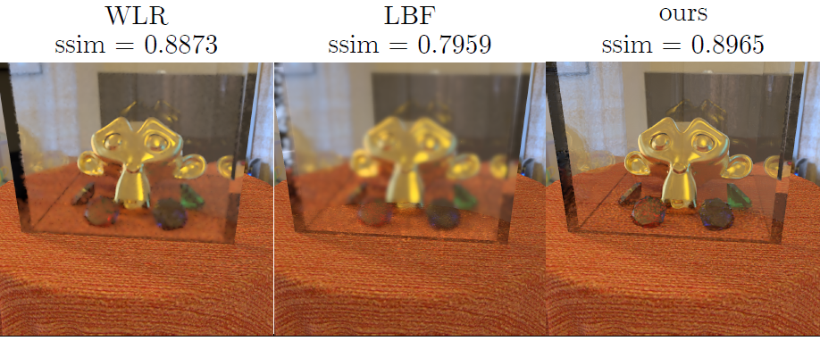
Results: feature-based fail case

Slide 46
Results: participating media

Slide 47
Bayesian Collaborative Denoising for Monte Carlo Rendering
Previous work: Ray Histogram Fusion
Algorithm
Extensions
Results
Discussion

Slide 48
Results: homogenous areas artifacts

Slide 49
Discussion
Drawbacks
Benefits
Homogenous areas artifacts
Not as good as feature-based when features are very relevant
Samples should be i.i.d.
Spikes not naturally handled
  Needs pre-filtering pass
Number of samples (>50)
  Matches production constraints
Enhancing state-of-the-art of sample-based denoising (RHF)
  in quality
  in timing
Particularly useful when features are not relevant (complex scenes)
Low invasiveness, simple to implement
Universality (all effects handled)

Slide 50
Outline
Introduction
Theory: Bayesian denoising of Monte Carlo noise
Application: Bayesian Collaborative Denoising for Monte Carlo Rendering
Conclusion

Slide 51
Conclusion
Contributions
Future work
Bayesian denoising formula for the noise of Monte-Carlo rendering
Patch-based collaborative filtering
  Sample-based
  Improves RHF
  Not invasive
  General
Specific adaptive sampling scheme
Push further sample-based
  Other models / data structures?
Machine learning on samples?
  Collaborative denoising as a local online learning
Samples: rich and general data
Future: more complexity → generality matters

Slide 52
Thank you!
Project page:
http://www.telecom-paristech.fr/~boubek/papers/BCD/
Github repository for open source code:
https://github.com/superboubek/bcd

